Slide 1
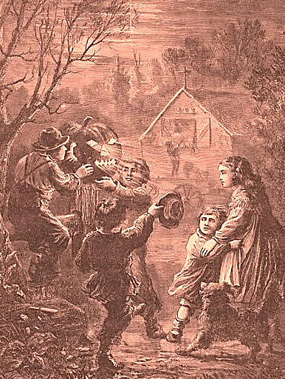

Things that Went
Bump in the Night in the
Early United States
Craig Thompson Friend

Slide 2


Slide 3
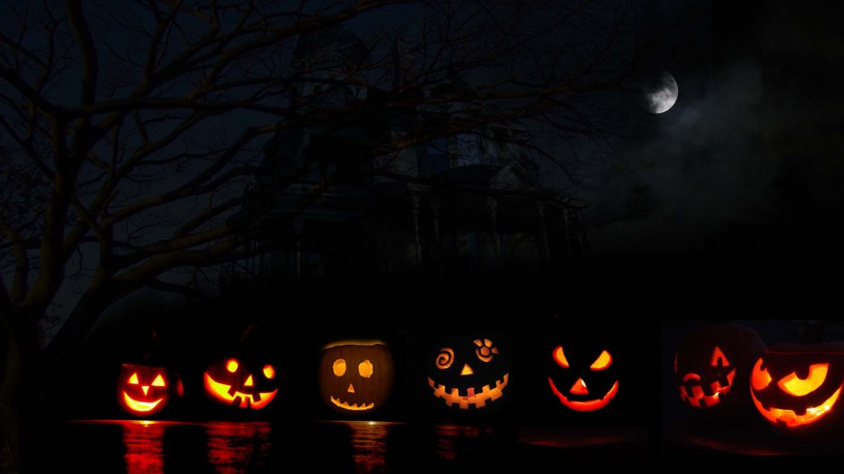
Guy Fawke’s/
Pope’s Night
Samhain
Pomona
All Saint’s
c. 2800 c. 100 c. 600 c. 1606
BCE BCE CE CE

Slide 4
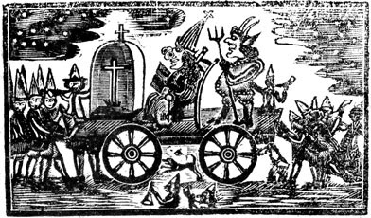
“Extraordinary verses on Pope-night. or, A commemoration the fifth of November, giving a history of the attempt, made by the papishes, to blow up king and Parliament, A. D. 1588,” 1768, Library of Congress.

Slide 5
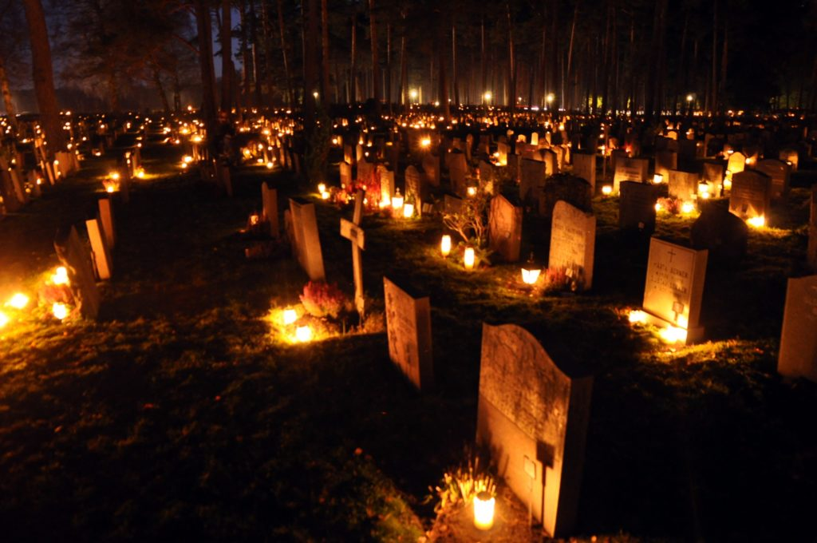
October 31 All Hallow’s Evening
November 1 All Saints Day Hallowtide
November 2 All Souls Day
November 3
November 4 Pope’s Night
November 5 Guy Fawke’s Day

Slide 6
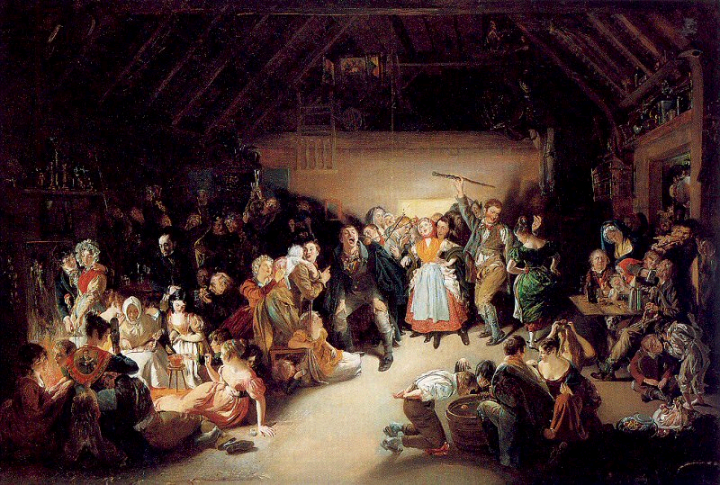
Daniel Macleise, Snap-Apple Night, or All Hallow Eve, 1833, Elisha Whittelsey Collection, The Metropolitan Museum of Art,
New York.

Slide 7
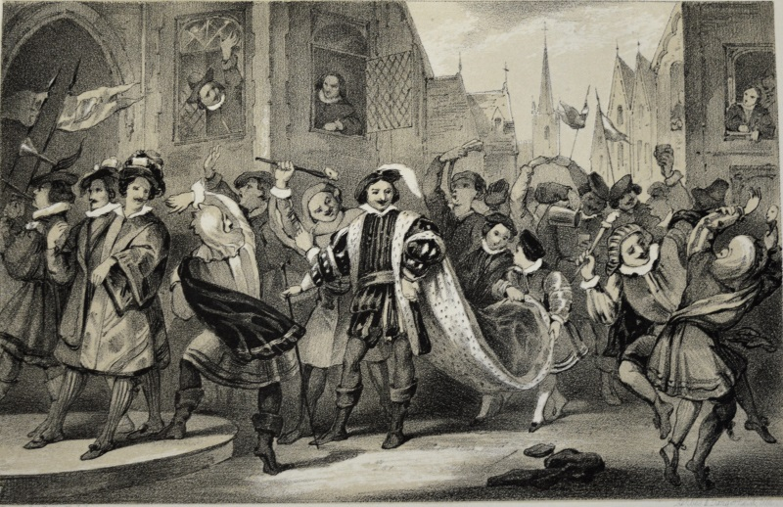
“Lord of Misrule,” from William Sandys, Christmastide: its History, Festivities and Carols (London, 1852), University of Leicester Special Collections, SCM 12913

Slide 8
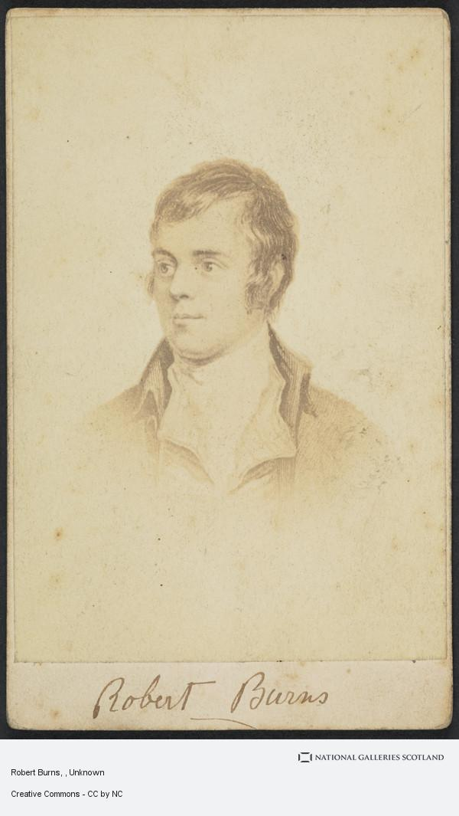
Upon that night, when fairies light
On Cassilis Downans dance,
Or owre the lays, in splendid blaze,
On sprightly coursers prance; . . .
Some merry, friendly countra folks,
Together did convene.
To burn their nits and pou their stocks,
An’ haud their Halloween
Fu’ blythe that night.
Robert Burns, “Halloween” (1785)
Unknown, “Robert Burns,”
Scottish National Portrait Gallery

Slide 9
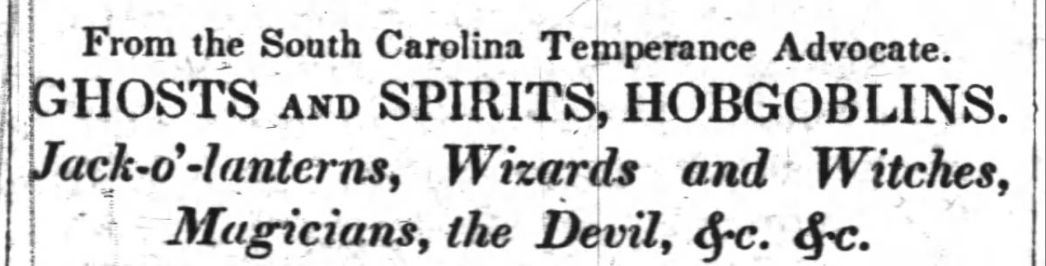
Carolina Watchman (Salisbury),
2 November 1844.

Slide 10
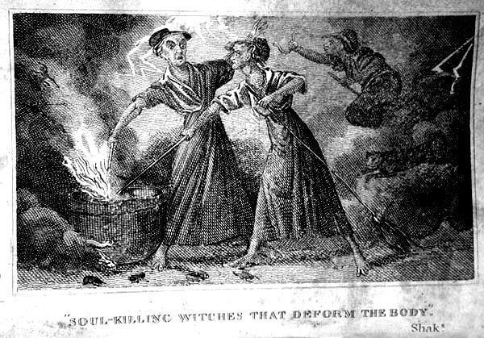
Supernatural
Preternatural
Beings
Wonders
Natural
Witches & Wizards
“Soul-Killing Witches that Deform the Body,” in Robert Calef, More Wonders of the Invisible World (London, 1700; reprint Boston, 1828).

Slide 11
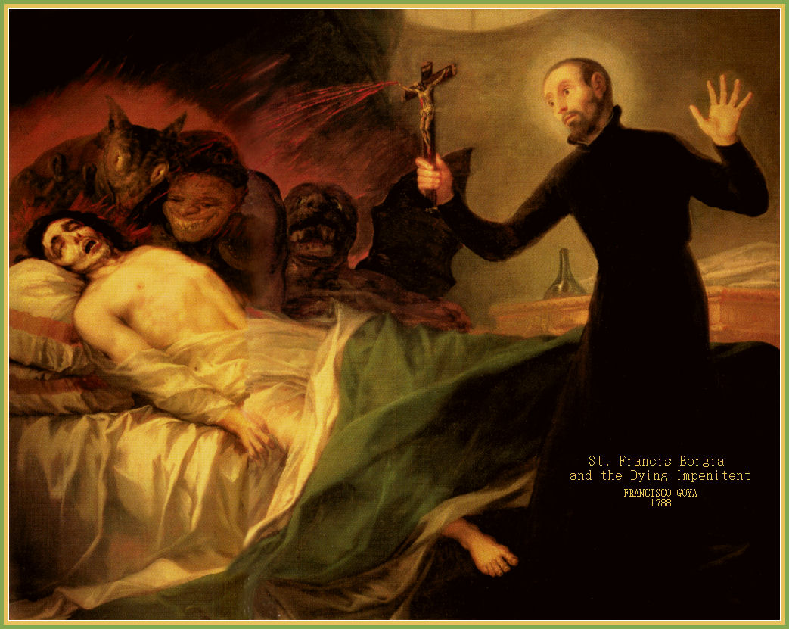
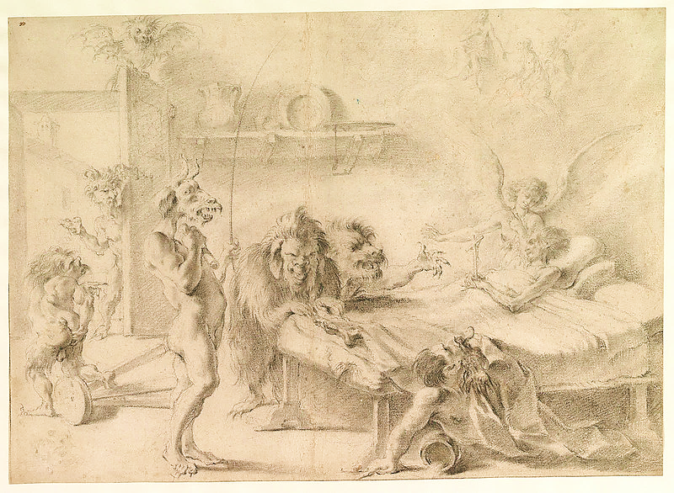
Francisco Goya, Saint Francis Borgia at the Deathbed of an Impentient, 1788, Valencia Cathedral, Chapel of St. Francis of Borgia.
Aureliano Milani, An Old Man on His Deathbed Tempted by Demons, early 18th century, Metropolitan Museum of Art, New York.

Slide 12
A Ghost—Spiritus—is a supernatural appearance, the seeing of which, generally precedes some great disaster or benefit to the beholder.

Slide 13
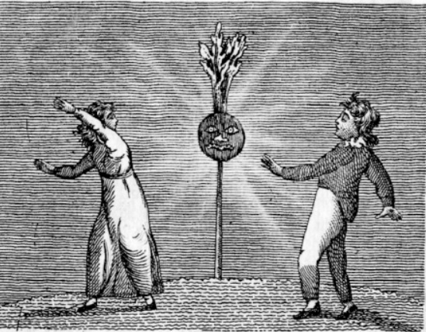
“Faux Ghost,” Tale for Young Children (1810), American Antiquarian Society.

Slide 14
A Hobgoblin—Terricalum—I think may be termed a degenerate ghost. That is, they are the progeny of ghosts, who have intermarried until their race has become small and idiotic.

Slide 15
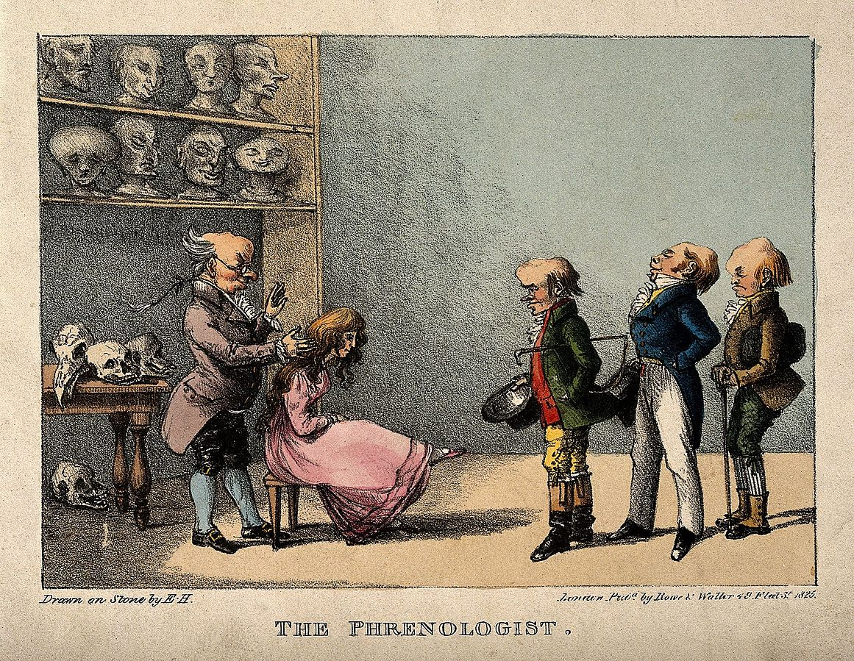
“Franz Joseph Gall examining the head of the pretty young girl,” (London, 1825)

Slide 16
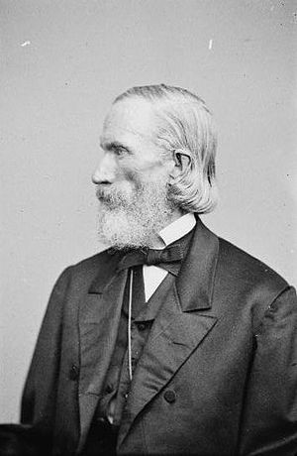
O.S. Fowler, Prints and Photographs Division,
Library of Congress

Slide 17
A Jack-o-lantern or Jack-with-a-lantern—Ignis Fatuus—is a different order of beings. . . . They are, generally speaking, an unhealthy race, hold no communion with other supernatural appearances, and though fewer in number than ghosts, are much more dangerous, and should be avoided.

Slide 18
“Faux Ghost,” Tale for Young Children (1810), American Antiquarian Society.

Slide 19
O!—fruit loved of boyhood!—the old days recalling,
When wood-grapes were purpling and brown nuts were falling!
When wild, ugly faces we carved in its skin,
Glaring out through the dark with a candle within!
When we laughed round the corn-heap, with hearts all in tune,
Our chair a broad pumpkin—our lantern the moon,
Telling tales of the fairy who travelled like steam,
In a pumpkin-shell coach, with two rats for her team!
John Greenleaf Whittier, “The Pumpkin” (1849)

Slide 20
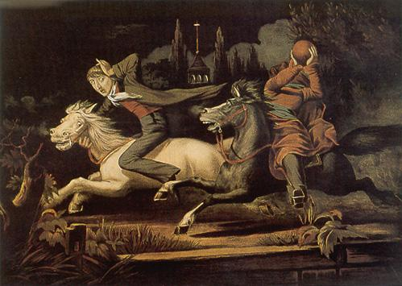
William J. Wilgus, Ichabod Crane, Respectfully Dedicated to Washington Irving (c. 1856), lithograph, National Gallery of Art.

Slide 21
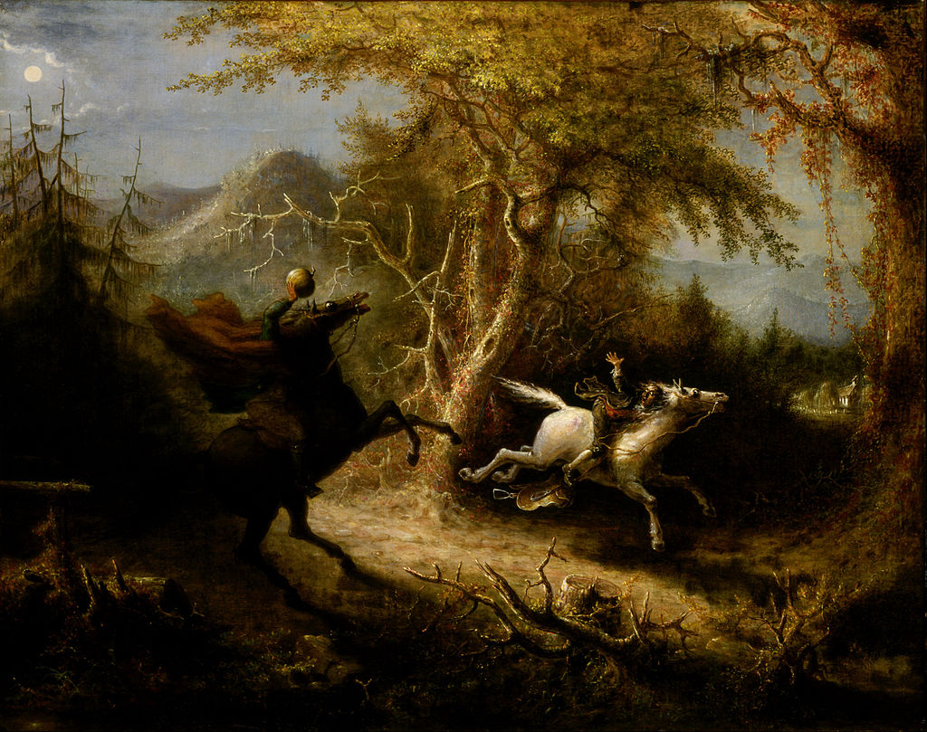
John Quidor, The Headless Horseman Pursuing Ichabod Crane (1858), American Art Museum.

Slide 22
Wizard or Witch—Hariolus Venefica—we have scripture for, (an authority we will never dispute.) That there have been witches we cannot deny, and if there have been, why not now as well as any time?

Slide 23
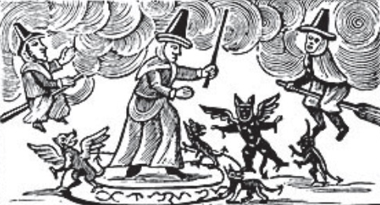
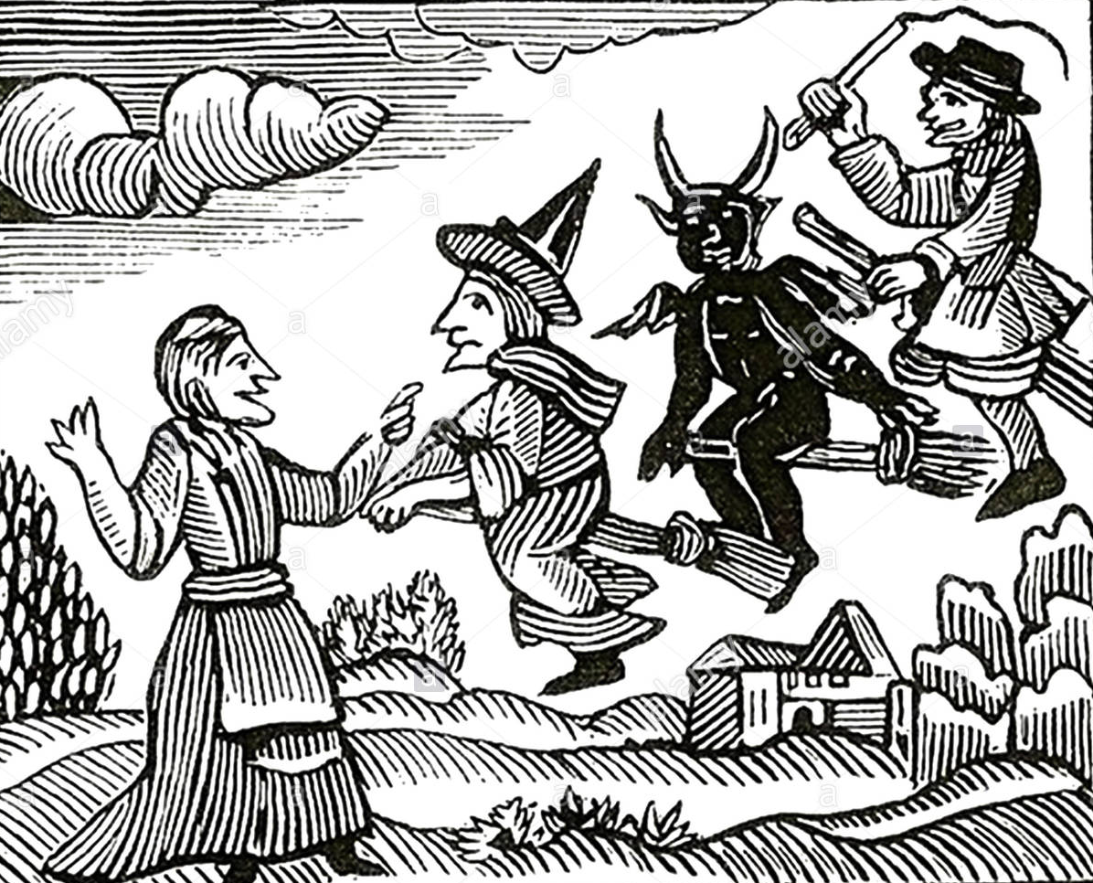
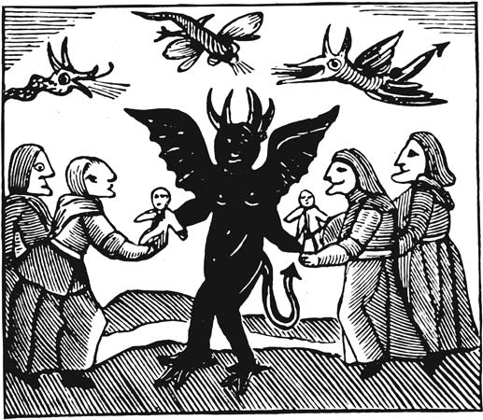
Woodcuts from Cotton Mather, “Wonders of the Invisible World” (1693)

Slide 24
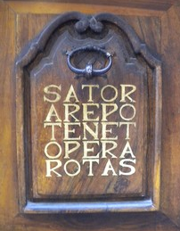

Slide 25
A Magician—Magus—is a mysterious person who waves wands, and commits several other deviltries.

Slide 26
A Magician—Magus—is a mysterious person who waves wands, and commits several other deviltries.

Slide 27
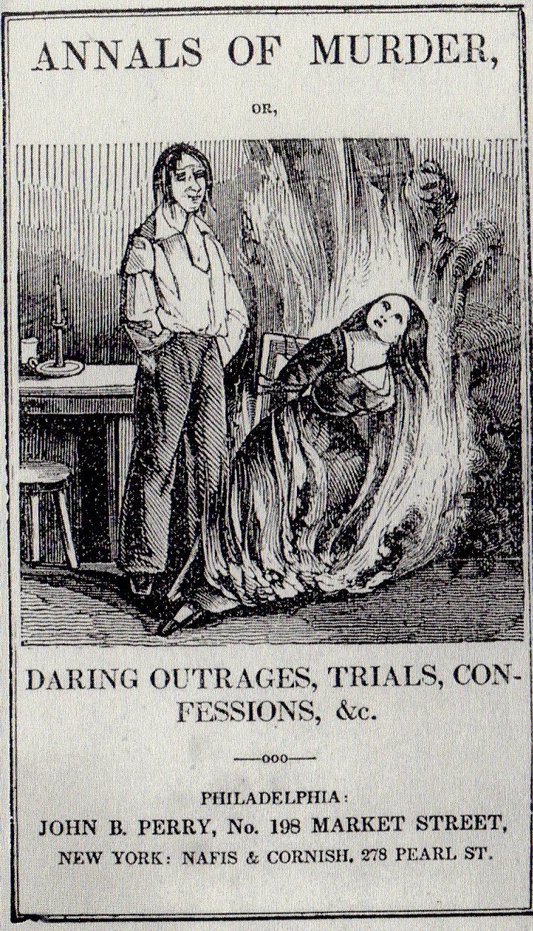
Annals of Murder, or, Daring Outrages, Trials, Confessions, &c. (Philadelphia: 1845)

Slide 28
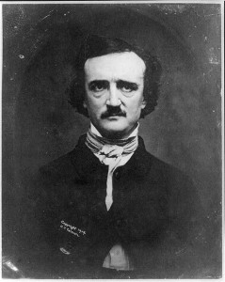
Dark Romanticism/Gothic
Mary Shelly, Frankenstein (1818)
John William Polidari, “The Vampyre” (1819)
Edgar Allen Poe, 1840s

Slide 29
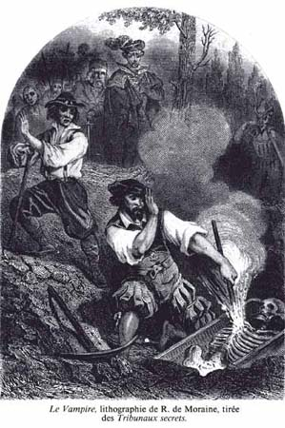
. . . this morning [July 21, 1788] opened the grave of my daughter [Martha]... who had died—the last of my three daughters—almost six years ago ... On opening the body, the lungs were not dissolved, but had blood in them, though not fresh, but clotted. The lungs did not appear as we would suppose they would in a body just dead, but far nearer a state of soundness than could be expected. The liver, I am told, was as sound as the lungs. We put the lungs and liver in a separate box, and buried it in the same grave, ten inches or a foot, above the coffin.”—Rev. Justus Forward, Belchertown MA,
Paul-Henri-Corentin Féval, Les Tribunaux Secrets (Paris: Boulanger et Legrand, 1864), 2: 112.

Slide 30
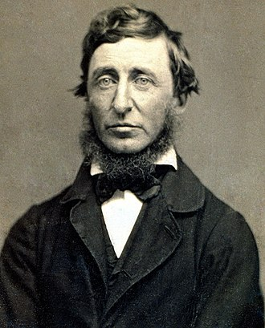
“The savage in man is never quite eradicated. I have just read of a family in Vermont—who, several of its members having died of consumption, just burned the lungs & heart & liver of the last deceased, in order to prevent any more from having it.”
Thoreau, Henry David, Bradford Torrey, and Francis H. Allen. "Journal." Journal. Vol. 30. New York: Dover Publications, 1962. N. pag.

Slide 31
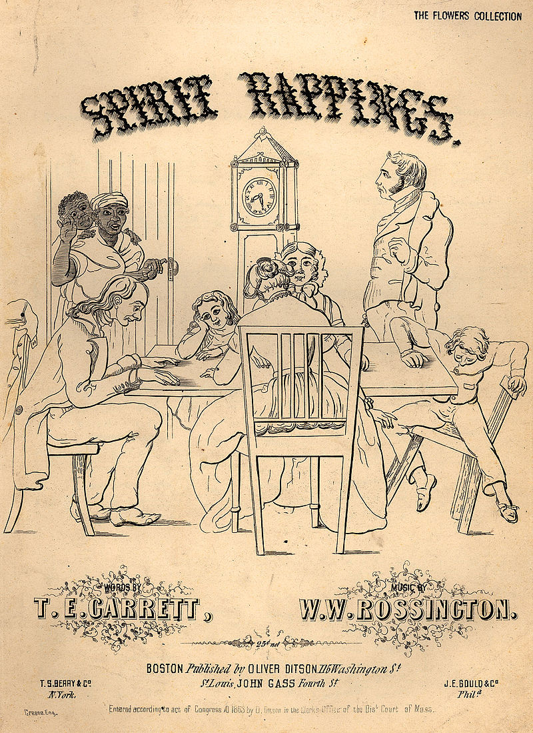
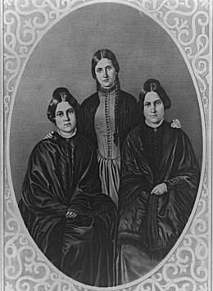
“Spirit Rappings,” 1853, Historical Sheet Music: 1850-1920, Rare Book, Manuscript, and Special Collections Library, Duke University.

Slide 32
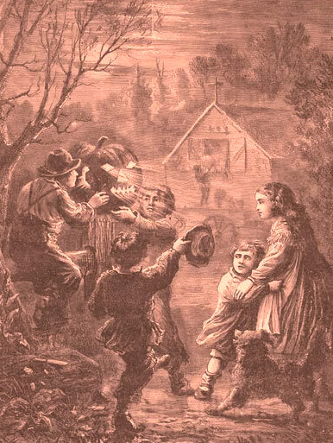
L.W. Atwater, “The Pumpkin Effigy,”
Harper’s Weekly, 23 November 1867.

Slide 33
Thank you, and
Happy Halloween!

