Slide 1
Ray of Light
The Joel Lane House’s Kitchen

Slide 2
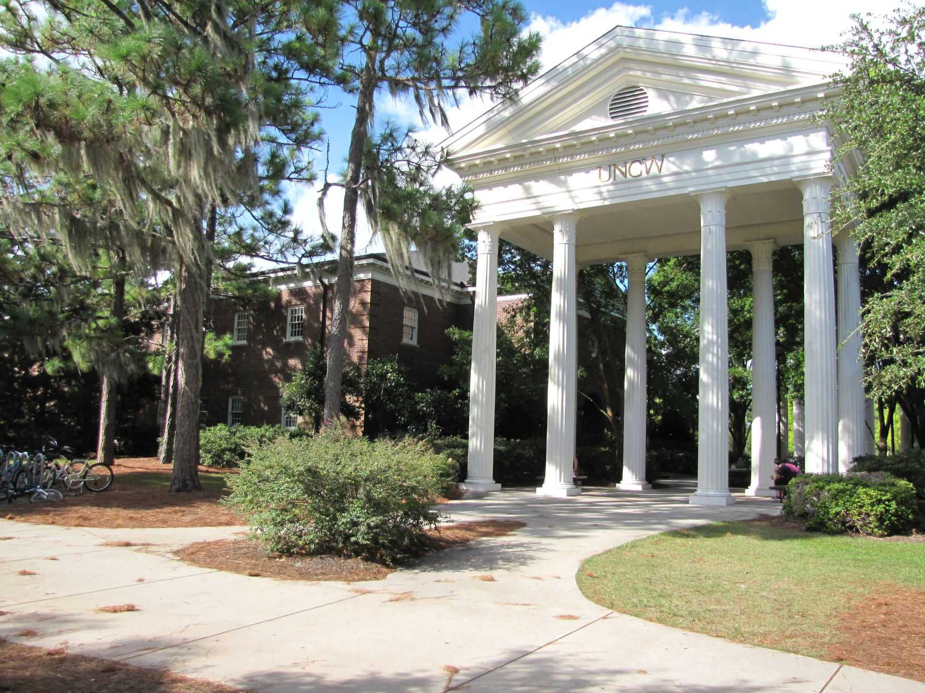
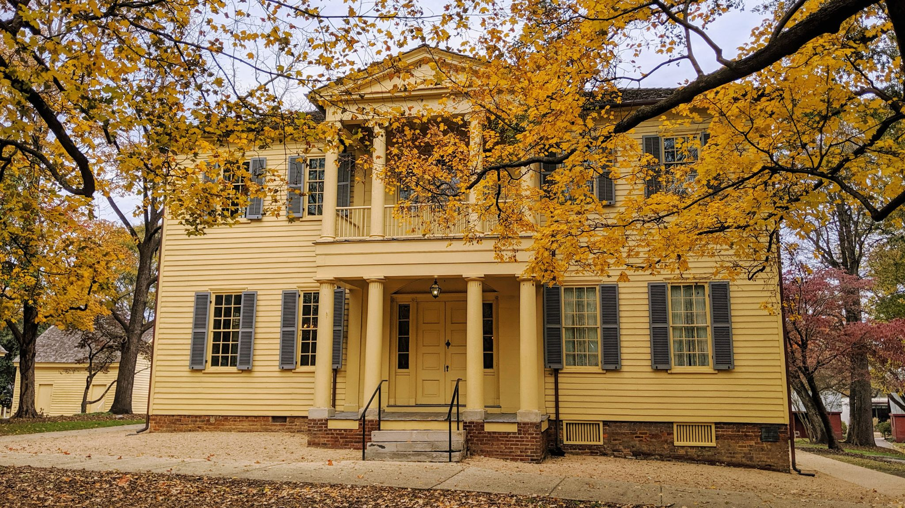
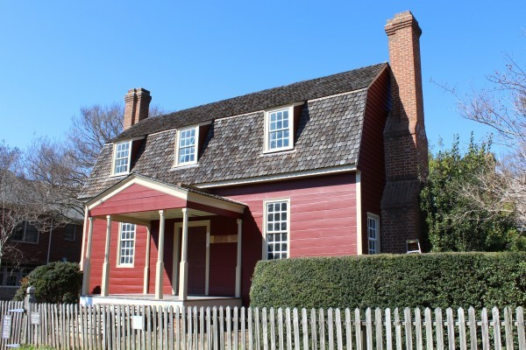
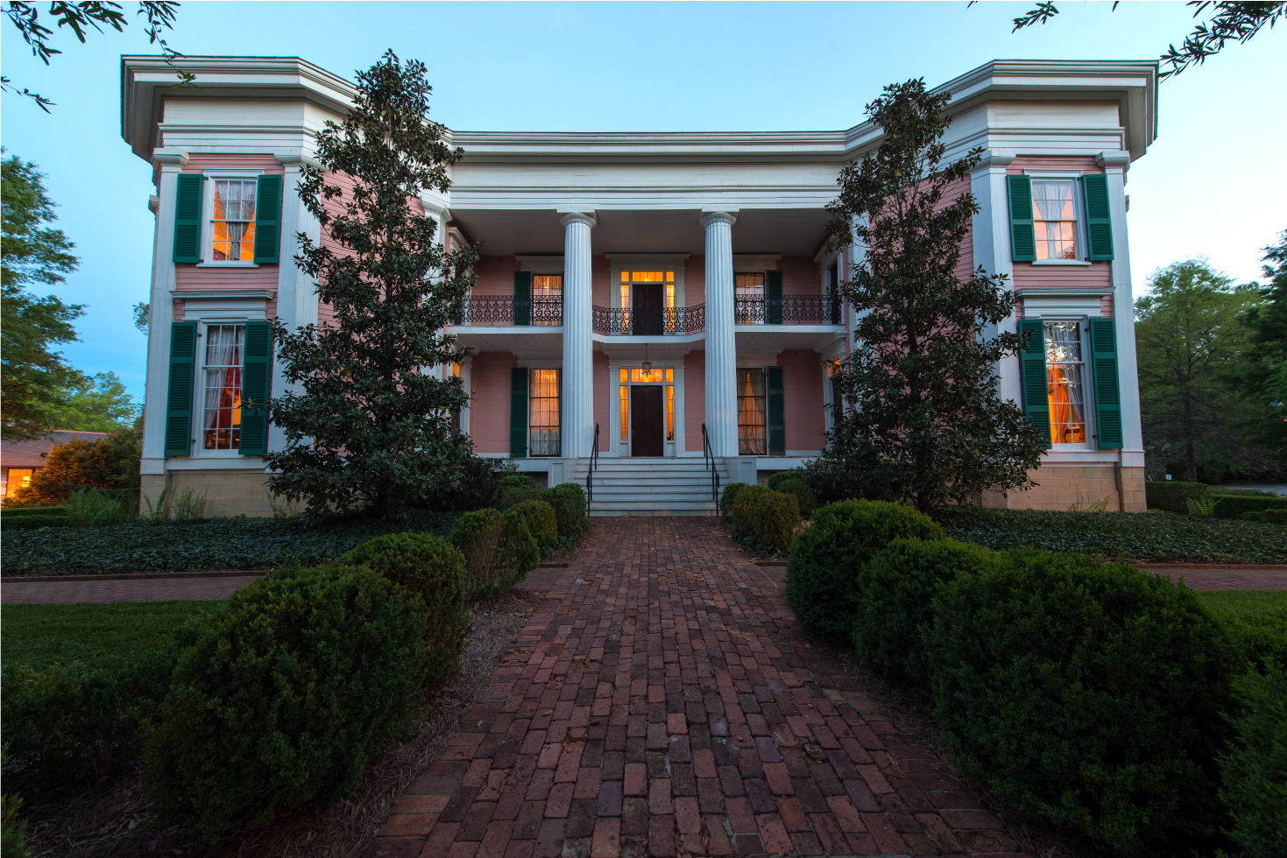
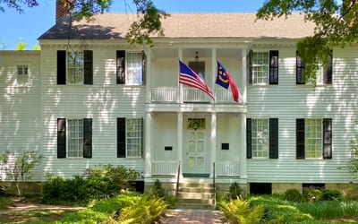
My Background
© The Seahawk
© raleighnc.gov
© Joel Lane Museum House
© Great American Treasures
© T.R.R. Cobb House

Slide 3
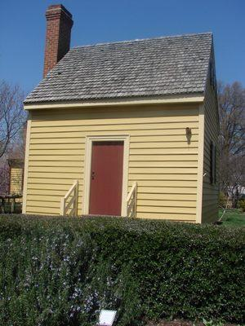
The “Kitchen”
Not original to the property
Moved in 1979
Previously located on the “Ray farm in northern Wake County”
Binder in the kitchen specifically mentioned Adlie Ray
“Middle-class dwelling” that housed a whole family in its two rooms
Preservation, not a restoration
Original:
Door molding and window sills
Board siding on the front
Wooden pegs joining base timbers
Not original:
Fireplace and chimney
Roof
© Atlas Obscura

Slide 4
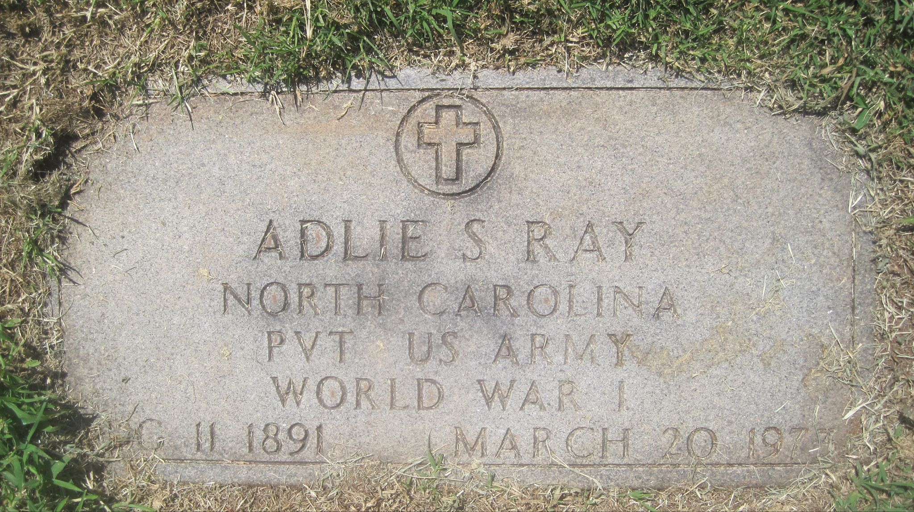
Adlie Stevenson Ray (1891-1973)
Born in New Light District (northern Wake County)
Son of Joseph Nathan Ray and Ella Burton Keith
Six siblings
Served in World War I
Drafted in 1918
Claimed a physical disability on his draft card
Service card said he did not have one
Never served overseas, honorably discharged January 1919
Lifelong farmer
Married Lonie Lowery after being discharged
No children
1930 Census indicates they rented their home “on Highway no. 55” in New Light District around Wake Forest
1940 Census says they outright own their home
Lonie passed away in 1961
Later married Cloey Mangum
© Mary Ann Loss, FindAGrave

Slide 5
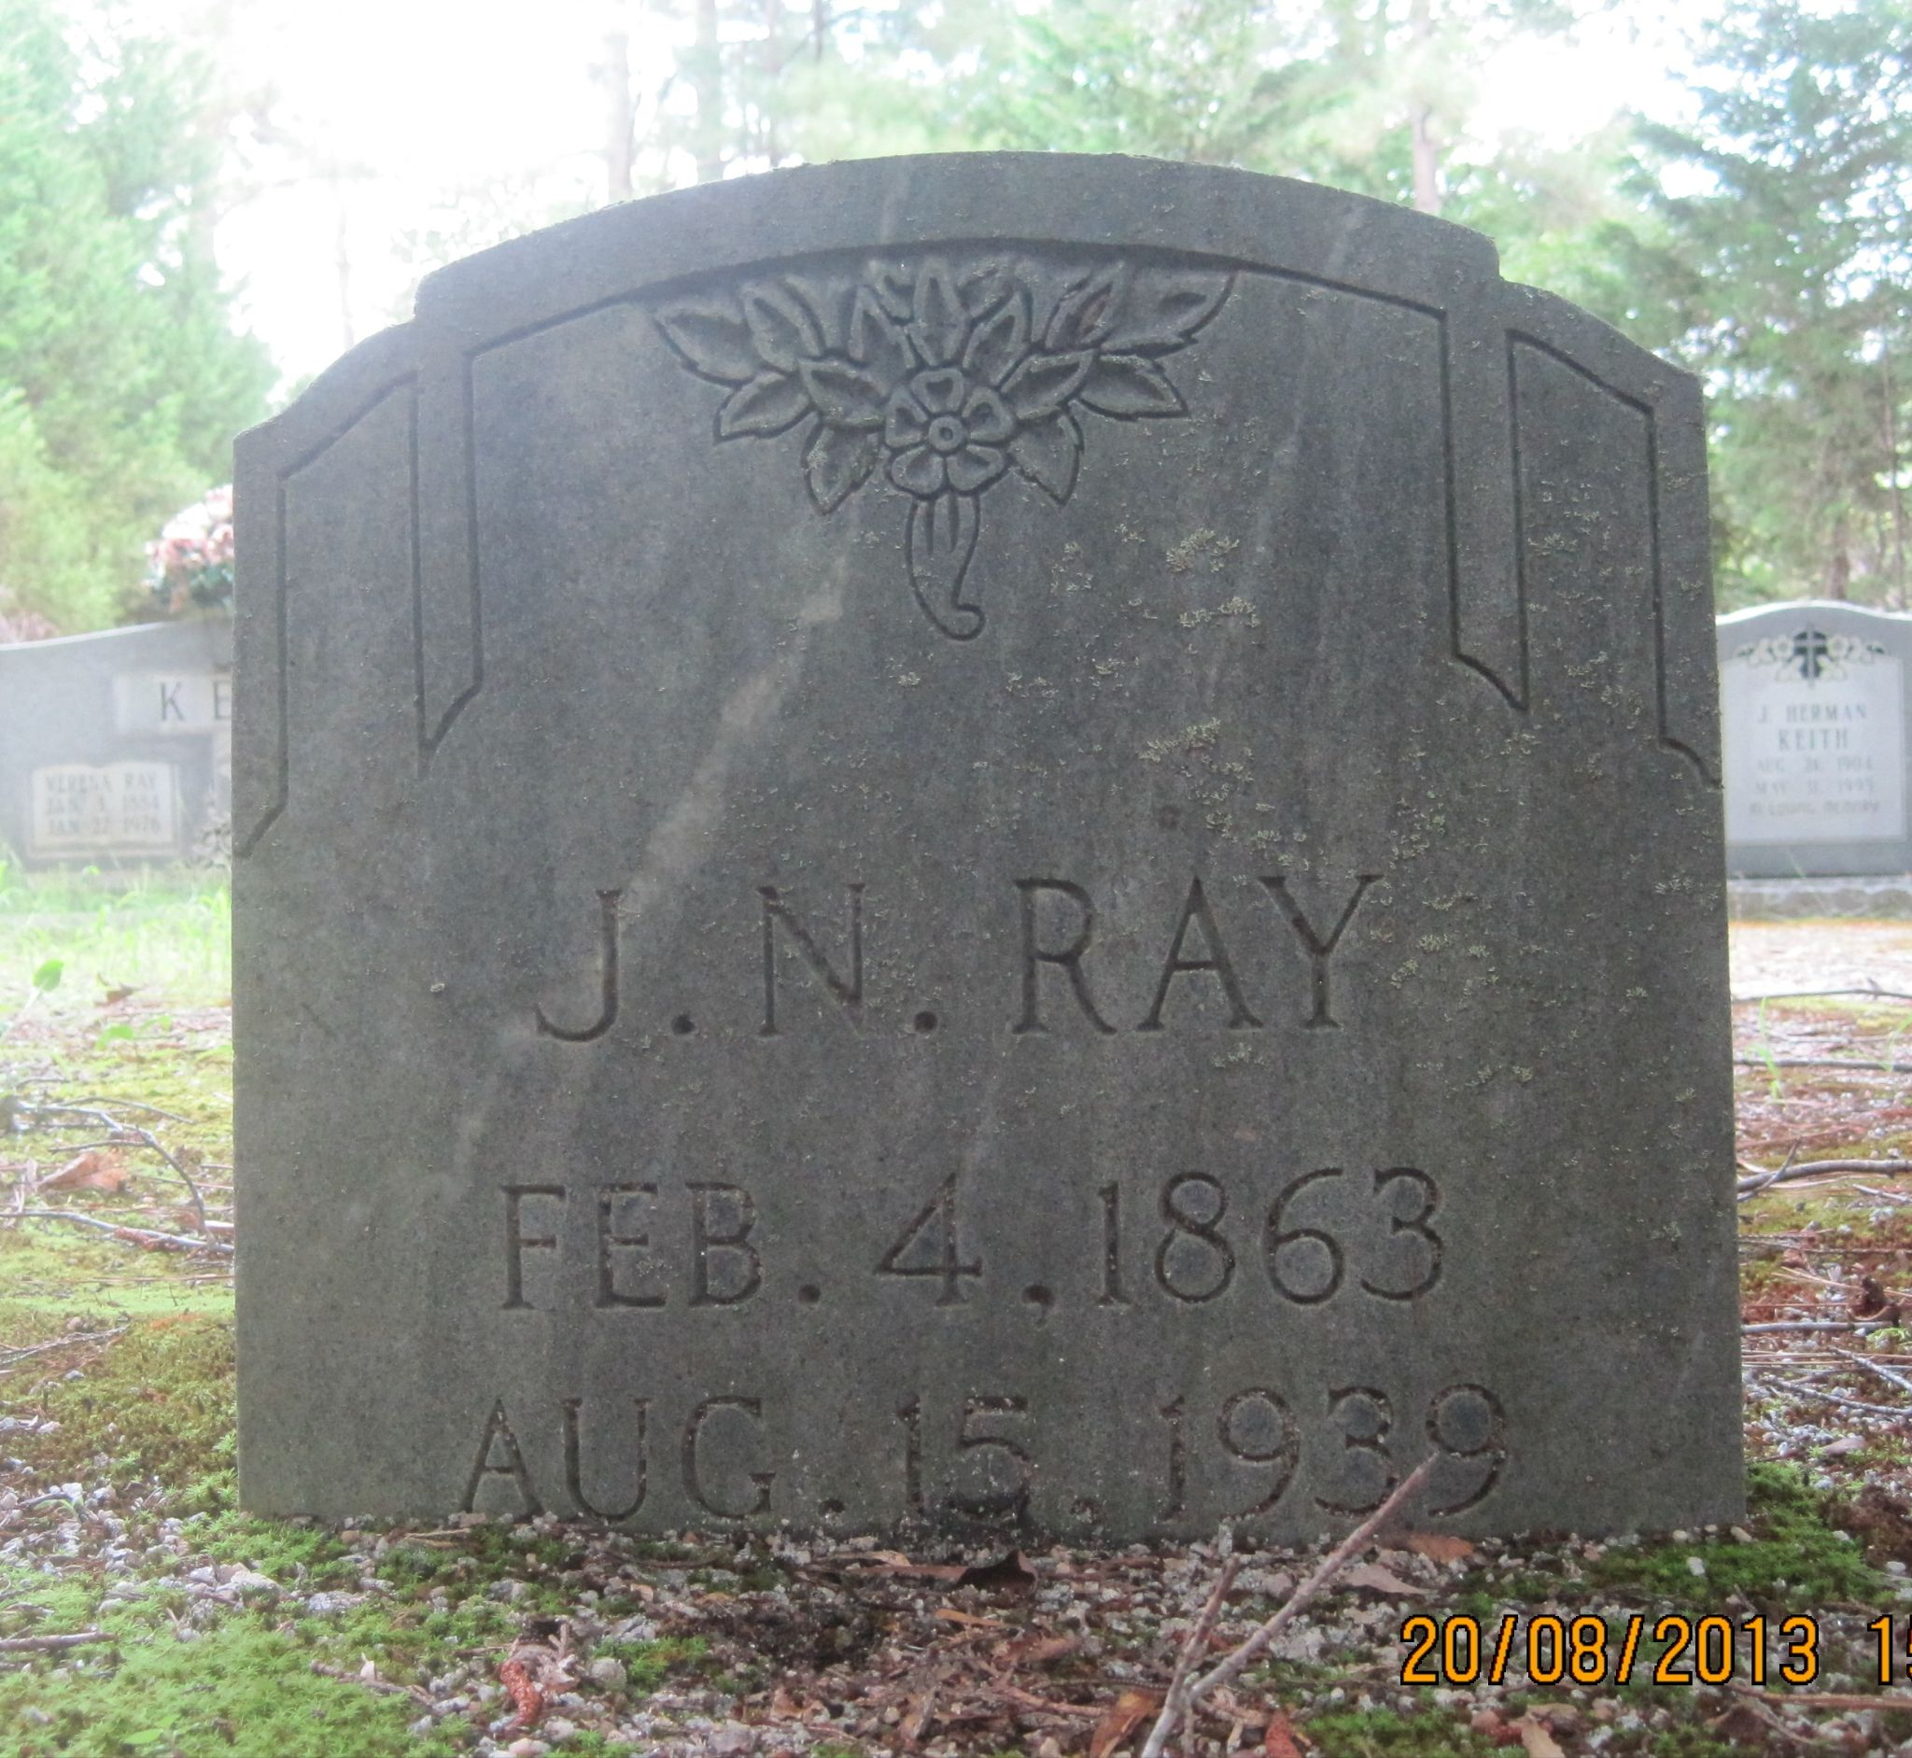
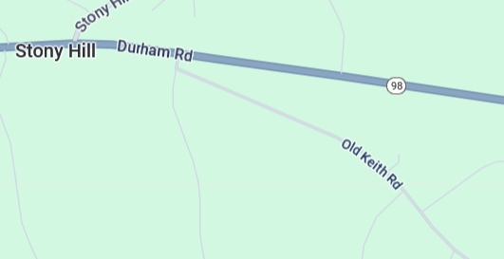
Joseph Nathan Ray (1863-1939)
Son of Thomas Ray and Lina Harrison
Lived in Bartons Creek Township and New Light
Lifelong farmer
Lived in New Light almost his entire life
Lived in Granville County in the 1930 Census
Rented his house in New Light
Located on Keith Road according to the 1920 Census
© Mary Ann Loss, FindAGrave
© Google Maps

Slide 6
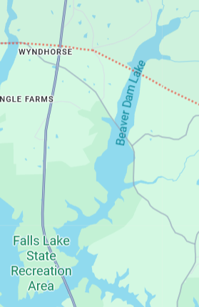
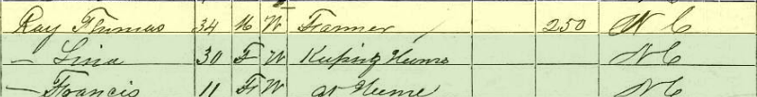
Thomas N. Ray (1836-before 1900)
Born in Beaver Dam District in Granville County
First recorded in Wake County in 1860
No real estate
Lifelong farmer
Lived in Bartons Creek and New Light
© Ancestry, 1870 census
© Google Maps

Slide 7
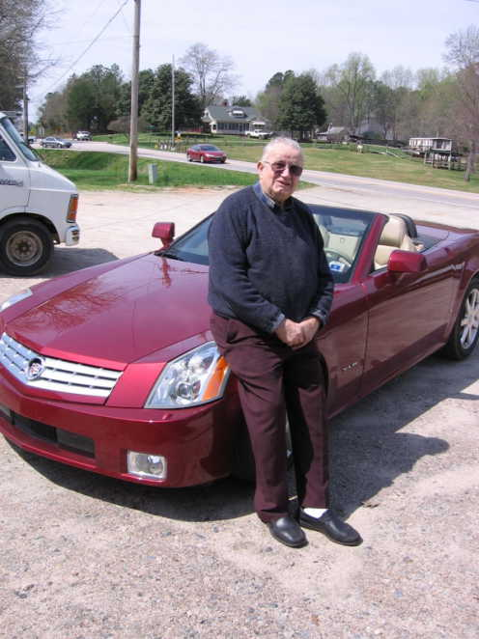
Rufus Nelson Leonard (1934-2012)
Resident of Wake Forest
Born “right where the No. 9 green at Wakefield Country Club is now”
Owned Tar Heel Veterinarian Supply near the intersection of Falls of Neuse Road and NC Highway 98
Came into possession of Adlie Ray’s property after his death in 1973
Part of the Tar Heel Estates development, which Leonard owned (The Wake Weekly, July 28, 1977)
Offered one of the buildings on the property to the Colonial Dames in 1979
Mother was Iva Keith
R. Nelson and Adlie were cousins
© Patricia Jordan, FindAGrave

Slide 8
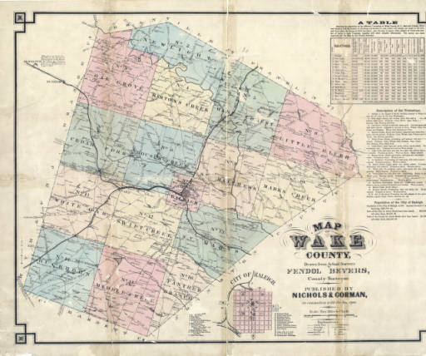
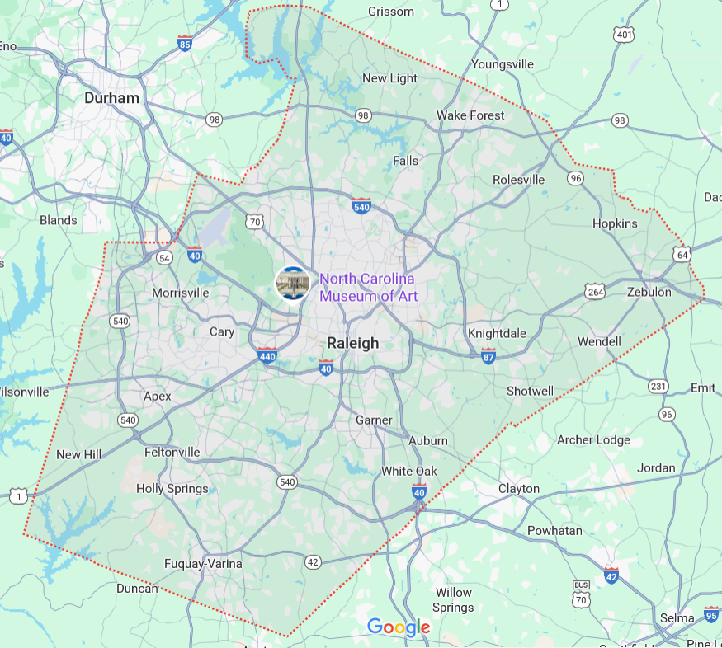
So where are we?
Fendol Bevers’s 1871 map of Wake County, State Archives of North Carolina

Slide 9
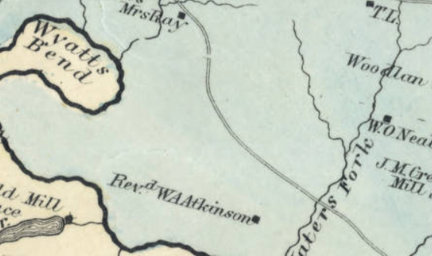
Who owned the land?

Slide 10
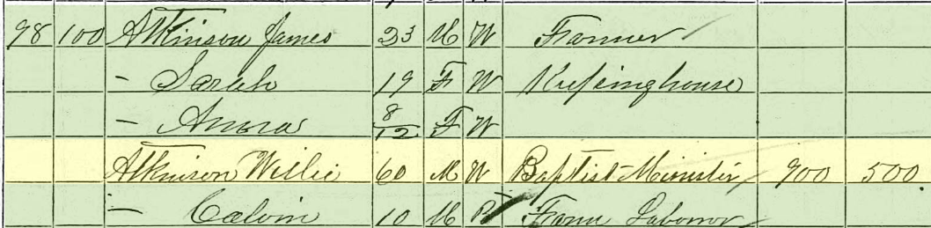
Rev. Wiley A. Atkinson (~1810-1891?)
From South Carolina
Moved to Wake County sometime before 1830
Married Emily Terrell in 1837
Had one known child: James, born 1847
Baptist minister with the Flat River Association based in Granville County
© Ancestry, 1870 census
The Biblical Recorder, August 14, 1872 - “...an esteemed minister of 30 years standing, recently prostrated by paralysis, and is now lying very ill at his home.”

Slide 11
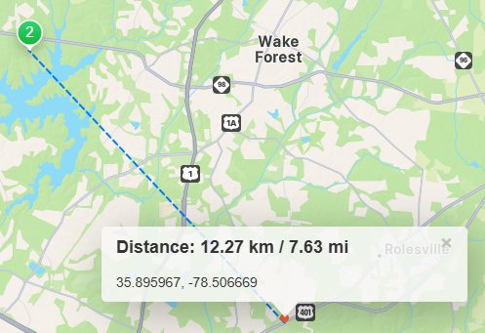
Joseph Henry Terrell (1785-1830)
Wiley Atkinson’s father-in-law
Lived “about 5 miles from Rogers’ cross roads” in 1818 (The Star, and North-Carolina State Gazette, June 26, 1818)
Modern-day Wake Crossroads near Rolesville
Died intestate but had a large personal estate including enslaved people, stock, “farming utensils,” and cash
Ailey, a woman enslaved to Henry, was given to Wiley upon Henry’s death
Was not willed a plot of his father’s plantation on Marsh Creek in 1816
Likely already had property
© gps-coordinates.net

Slide 12
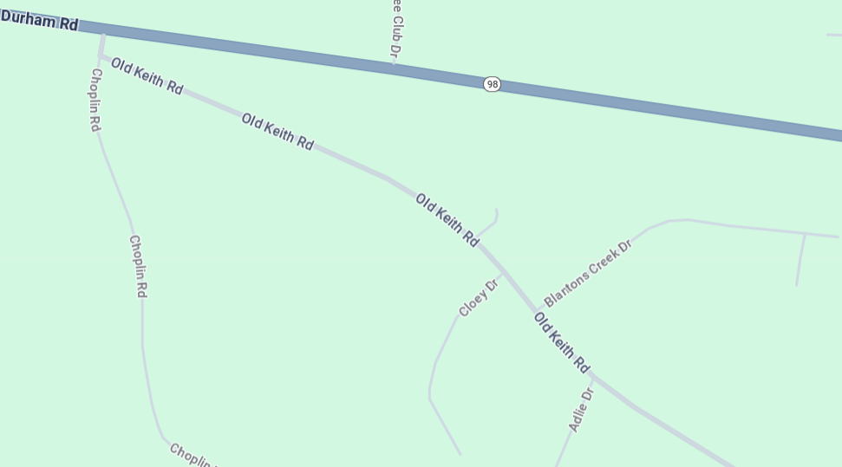
Where exactly was the building?

Slide 13
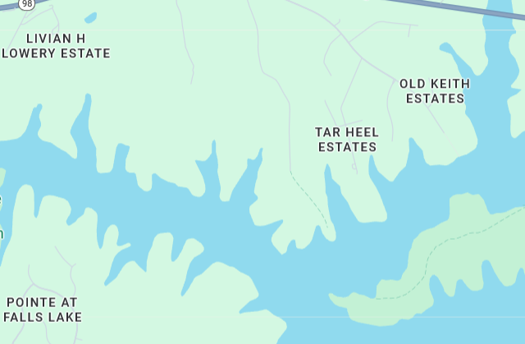
Why was it moved?
Falls Lake began construction in 1978, the year before R. Nelson Leonard offered the building on the Ray’s property to the Colonial Dames

Slide 14
The Theory
Structure was built in the 1790s - unsure at the moment exactly who it belonged to originally
Sometime before 1816, Joseph Henry Terrell gained ownership of the property
Inherited from his wife, Elizabeth Fort, or purchased it from someone else
After Henry Terrell’s death in 1830, stayed in the family until Rev. Wiley A. Atkinson married Emily Terrell in 1837, then the property went to them
The Rays moved down from Granville County and started renting from Atkinson
Atkinson continuously owned the property until his death in 1891
Unsure who owned it after him, potentially his son James or another person entirely
Adlie Ray, the third generation of Rays in Wake County, eventually gained ownership of the property in the 1930s and owned it until his death in 1973
R. Nelson Leonard, distant cousin of Adlie Ray, bought the property and developed it into Tar Heel Estates after Adlie’s death
Leonard offered the two-room, two-story structure to the Colonial Dames to save it from destruction as Falls Lake was being built and as his land development expanded

Slide 15
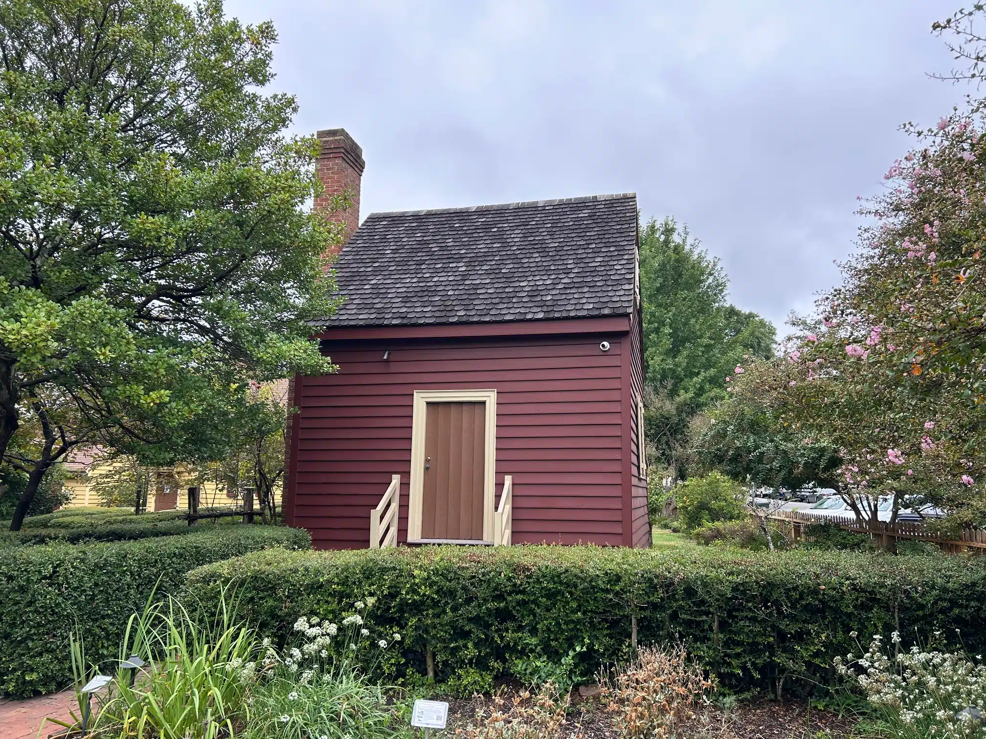
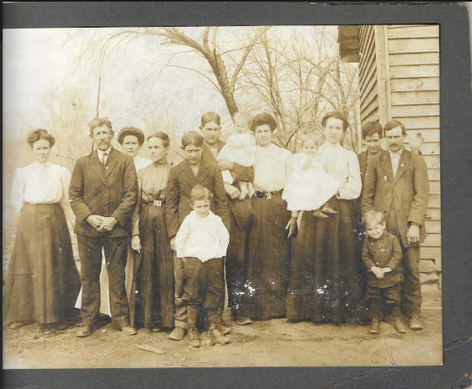
Was it a kitchen or a house?
Hard to say one way or the other
Henry Terrell was wealthy enough to enslave people, therefore not a small farmer
Not the original owner of that land
Building in the picture on the right is not the same as the structure at the museum
Not necessarily the Ray’s house though
No telling when the building at the museum was last used as either a kitchen or a house
Ray family, circa 1910, donated by Tom Ray

